Slide 1
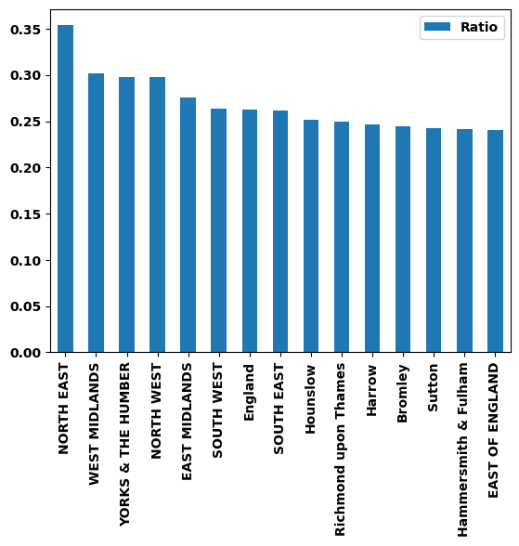
Which boroughs of London have seen the greatest increase in housing prices, on average, over the last two decades?
Conclusion:
North East borough seems to be expensive among others. The below chart shows the ratio of average price change in the last 2 decades. North East had a 35% increase in the housing price.

